Slide 1
MULTIPLE JOINS IN SQL
James Larkin – Data Analytics Instructor

Slide 2
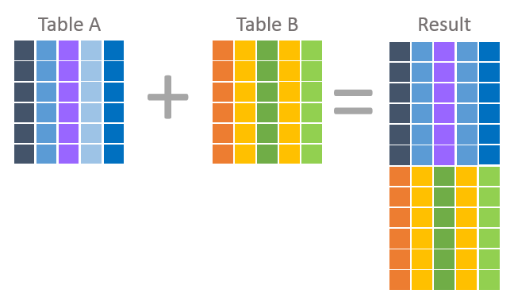
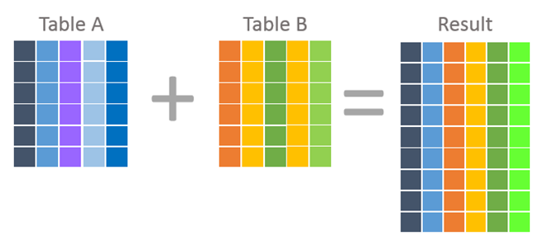
OPENING: LAST SESSION RECAP
Let’s review the following questions from our previous class:
What’s the difference between a JOIN and a UNION?
What Excel function is similar to JOIN?
How do aliases work with JOINS?
UNIONs
JOINs

Slide 3
LEARNING OBJECTIVES
MULTIPLE RELATIONSHIPS IN SQL
In today’s lesson, we’ll learn how to:
Create relationships between tables using:
INNER, RIGHT, and LEFT JOINs
FULL OUTER JOINs
EXCEPTION JOINs
Optimize queries using WHERE and LIMIT.

Slide 4
MULTIPLE RELATIONSHIPS IN SQL
INTRODUCTION:
TYPES OF JOINS

Slide 5
TYPES OF JOINS
As we’ve seen, SQL is written from left to right. The code is also read from left to right.
When you create JOINs, your first (or primary) table is known as the LEFT table and the second table is known as the RIGHT table.
OUTER and EXCEPTION JOINs assist you in handling missing data between tables.
PRO TIP: You’ll use INNER and LEFT JOINs 99% percent of the time.

Slide 6
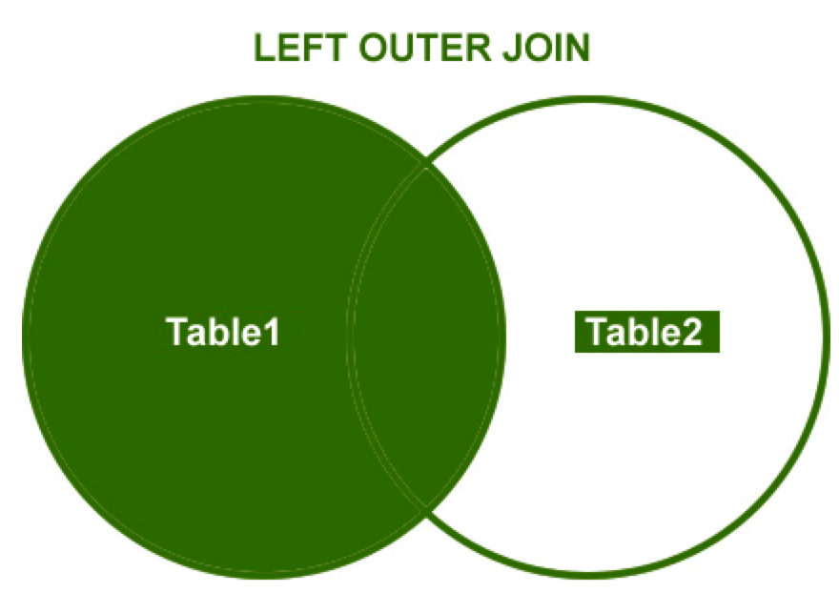
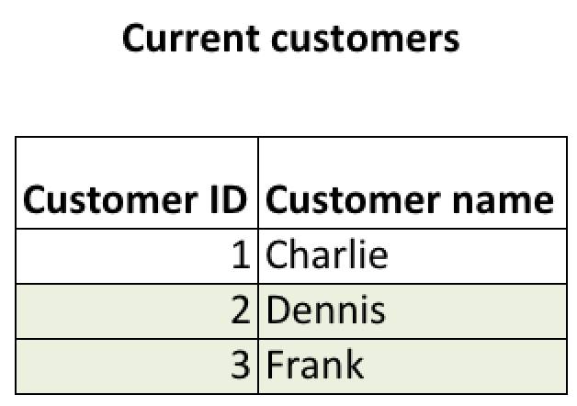
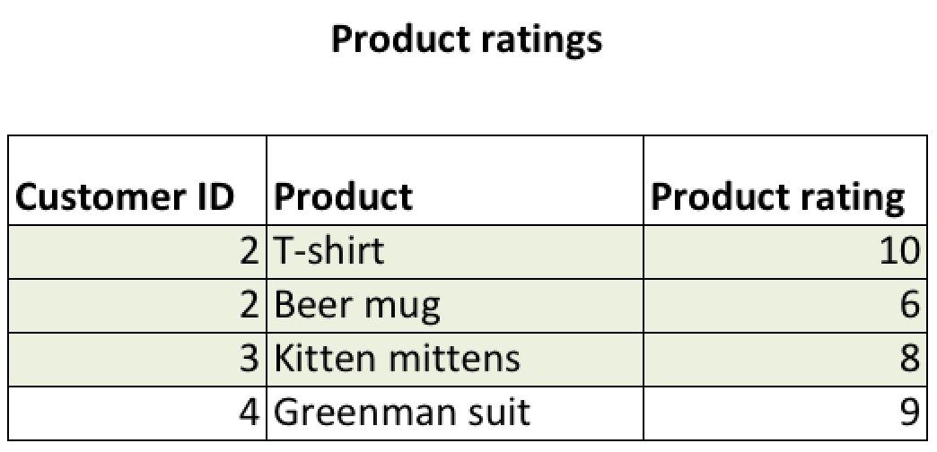
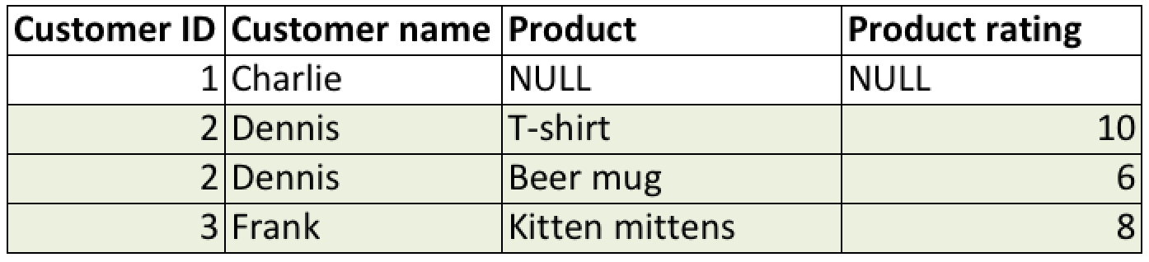
EXAMPLE: LEFT JOIN
SELECT
cc.Customer_ID,
cc.Customer_name,
pr.Product,
pr.Product_rating
FROM current_customers AS cc
LEFT JOIN product_ratings AS pr
USING(Customer_ID)
Bicycle Wheels
Left join on Customer ID result:
Bicycle Wheels

Slide 7
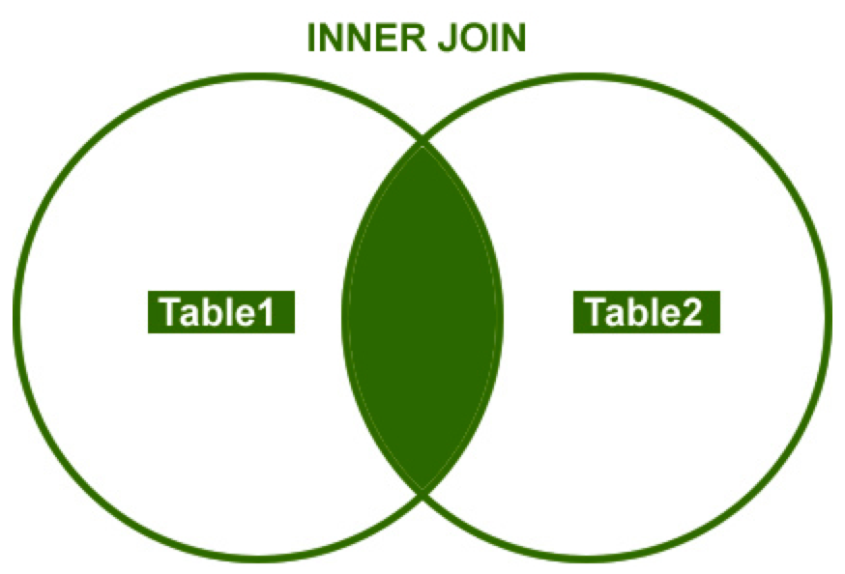
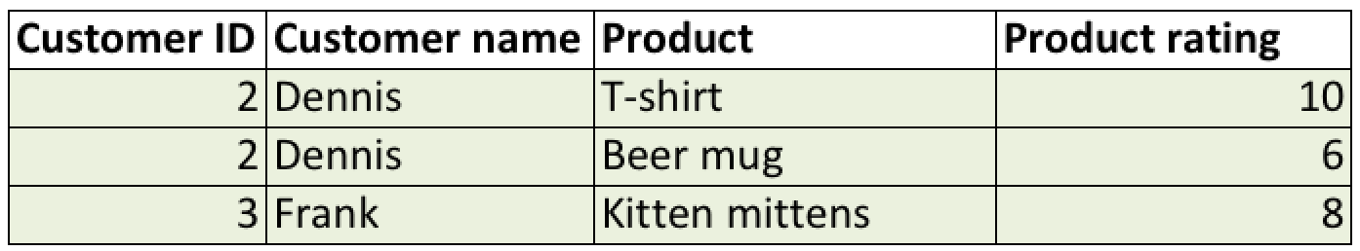
EXAMPLE: INNER JOIN
SELECT
cc.Customer_ID,
cc.Customer_name,
pr.Product,
pr.Product_rating
FROM current_customers AS cc
INNER JOIN product_ratings AS pr
USING(Customer_ID)
Bicycle Wheels
Inner join on Customer_ID result:
Bicycle Wheels

Slide 8
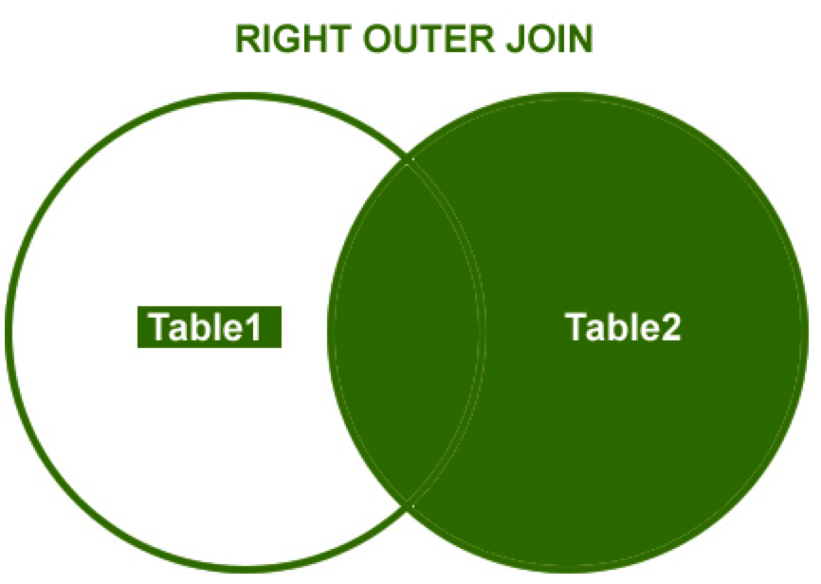
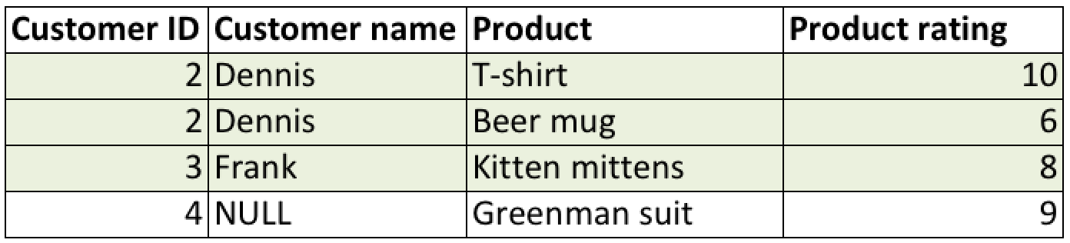
EXAMPLE: RIGHT JOIN
SELECT
cc.Customer_ID,
cc.Customer_name,
pr.Product,
pr.Product_rating
FROM current_customers AS cc
RIGHT JOIN product_ratings AS pr
USING(Customer_ID)
Bicycle Wheels
Right join on Customer ID result:
Bicycle Wheels
Notes:
.

Slide 9
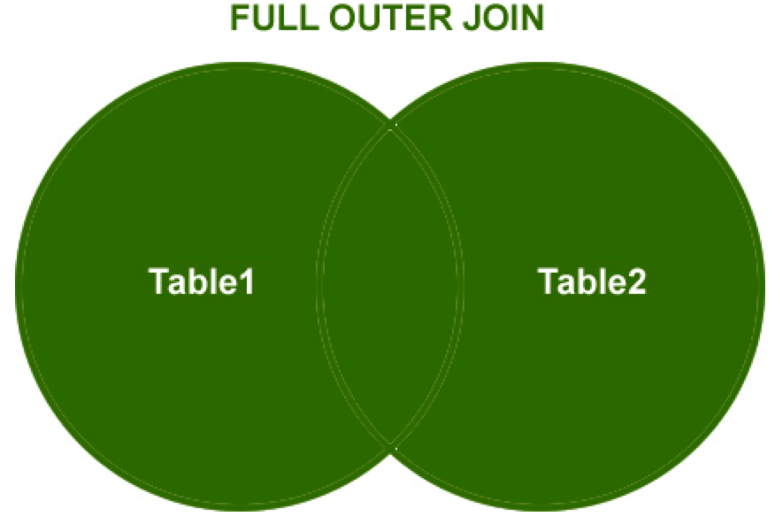
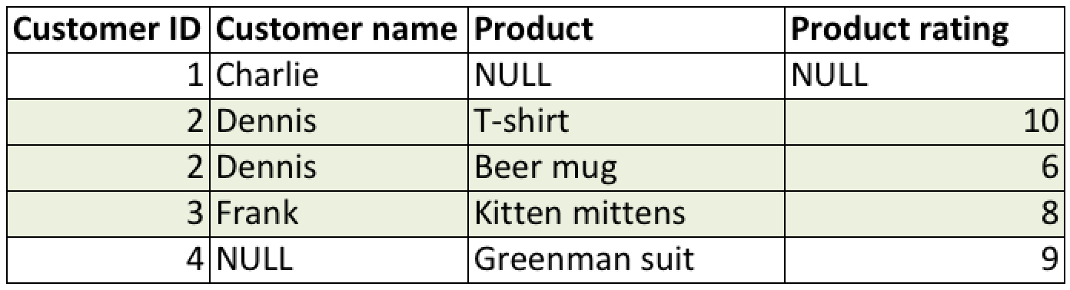
EXAMPLE: FULL OUTER JOIN
SELECT
cc.Customer_ID,
cc.Customer_name,
pr.Product,
pr.Product_rating
FROM current_customers AS cc
FULL JOIN product_ratings AS pr
USING(Customer_ID)
Bicycle Wheels
Full outer join on Customer ID result:
Bicycle Wheels

Slide 10
JOIN TYPES
Consider this example:
Your LEFT (FROM) table holds store numbers and sales.
Your RIGHT (JOIN) table holds store numbers and opening dates.
Your RIGHT (JOIN) table includes stores that haven’t opened yet and therefore do not have sales.
An INNER JOIN, which is an exact match, would end up filtering those new stores out of your results.
If you want to see store numbers whether or not they have sales, you need to do a RIGHT JOIN.

Slide 11
JOIN TYPES
On the next several slides, we’ll define each type of JOIN with examples using the following (fictitious) tables:
EMPLOYEES table: Contains information on employee names and has one row per employee.
SALARIES table: Contains information on employee salaries.

Slide 12
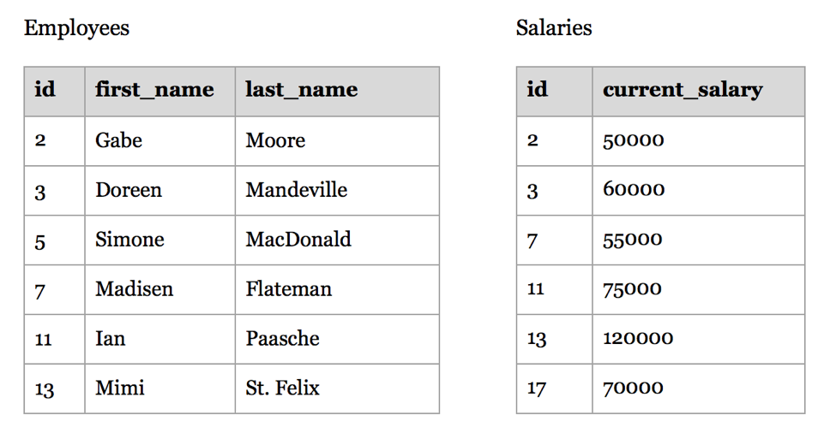
JOIN TYPES
EMPLOYEES
SALARIES

Slide 13
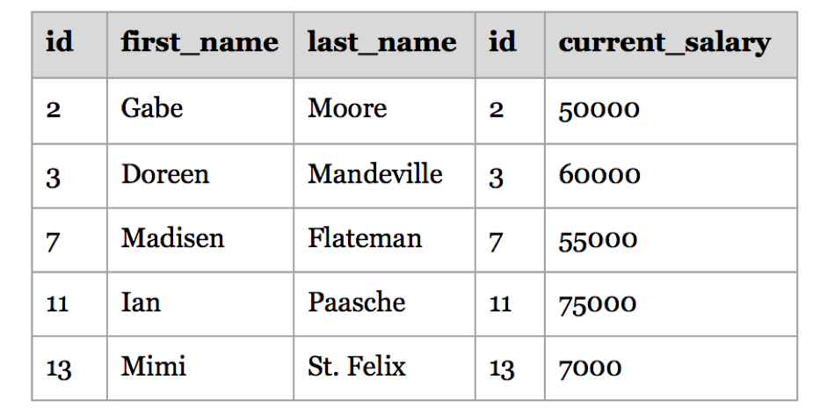
JOIN TYPES
An INNER JOIN displays only the rows that have matches in both joined tables.
Note that the * gets you everything across all tables. You use * to get just one column from the SALARIES table, you can write: employees.*, salaries.current_salary
An INNER JOIN would yield the table on the right.
SELECT * FROM employees
INNER JOIN salaries
ON employees.ID = salaries.ID;

Slide 14
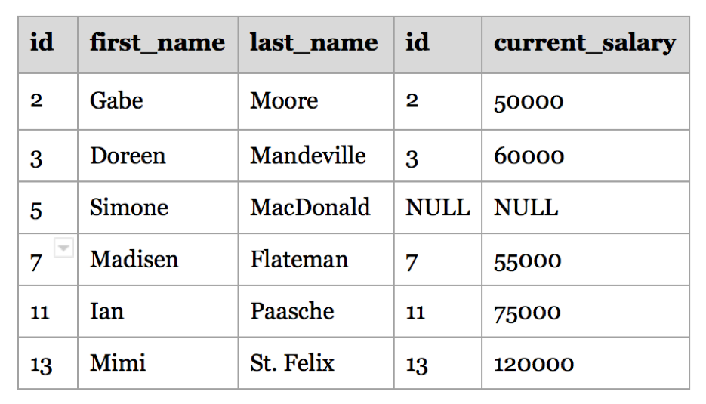
JOIN TYPES
SELECT * FROM employees
LEFT JOIN salaries
ON employees.ID = salaries.ID;
A LEFT JOIN yields:
Data that the left tables has, even if the right table doesn’t
Data from the primary table that doesn’t have matching data in the secondary table will show up as a NULL
A LEFT JOIN would yield the table shown here on the right.

Slide 15
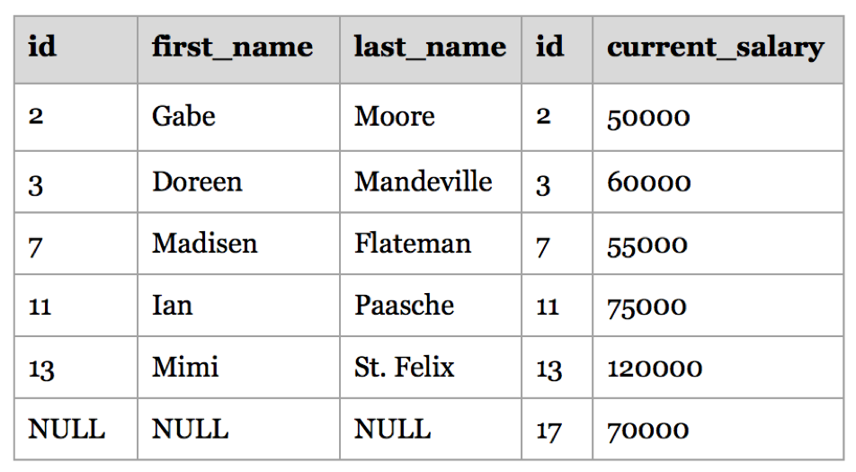
JOIN TYPES
A RIGHT JOIN yields:
Data that the right table (secondary) has, even if the left table (primary) doesn’t
Data from the secondary table selected that doesn’t have matching data to join to in the primary table
Note: logically equivalent to a left join where the primary and secondary table arguments are switched
A RIGHT JOIN would yield the table shown here.
SELECT * FROM employees
RIGHT JOIN salaries
ON employees.ID = salaries.ID;
Notes:
(NULL fields for ID #17)

Slide 16
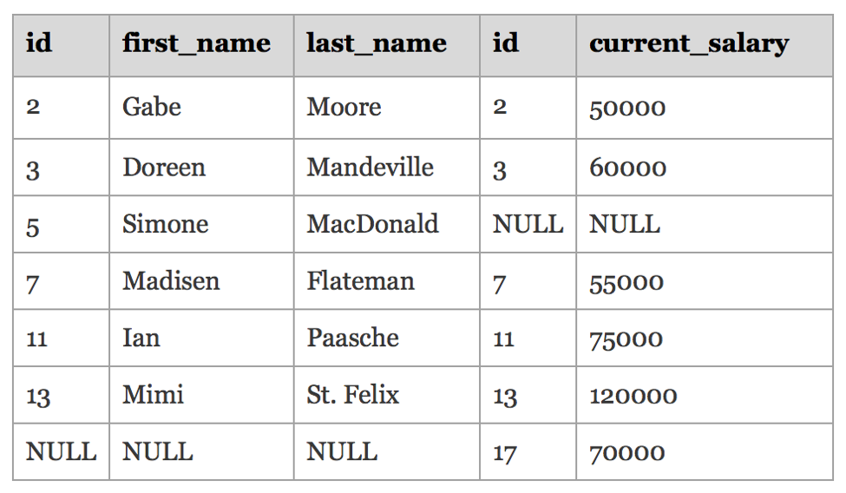
JOIN TYPES
A FULL JOIN returns all data from each table, regardless of whether they have matching data in the other table.
A FULL JOIN yields the table shown here.
SELECT * FROM employees
FULL JOIN salaries
ON employees.ID = salaries.ID;
Notes:
(NULL fields for Ids #5 and #17)

Slide 17
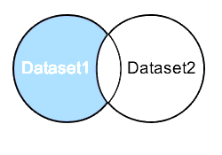
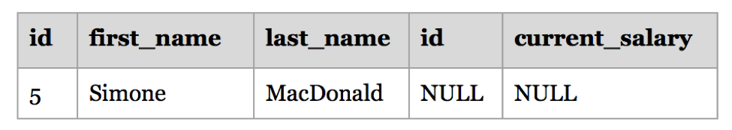

EXCEPTION JOINS
An EXCEPTION JOIN returns only the data from the primary - or first - table selected that doesn’t have matching data to join to in the secondary table.
An EXCEPTION JOIN with the EMPLOYEES table first would yield this result:
Pro Tip: pgAdmin includes the EXCEPT function for extracting exceptions.

Slide 18
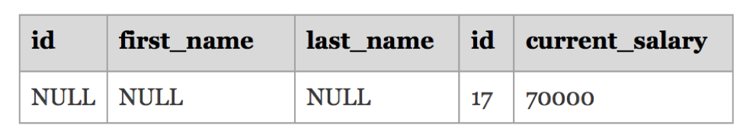
pgAdmin EXCEPT FUNCTION
SELECT * FROM employees
EXCEPT
SELECT * FROM salaries
“Return the records that exist in Table 1 but not in Table 2.”
SELECT * FROM salaries
EXCEPT
SELECT * FROM employees
“Return the records that exist in Table 2 but not in Table 1.”

Slide 19
pgAdmin EXCEPT FUNCTION
Next, let's look at an example of an EXCEPT query in PostgreSQL that returns more than one column:
SELECT contact_id, last_name, first_name
FROM contacts
WHERE last_name = 'Anderson'
EXCEPT
SELECT customer_id, last_name, first_name
FROM customers
WHERE customer_id < 99;
In this EXCEPT example, the query will return the records in the contacts table with any values from contact_id, last_name, and first_name value that do not match the customer_id, last_name, and first_name values in the customers table.

Slide 20
INNER, OUTER, EXCEPTION, AND CROSS JOINS
What type of JOIN should you use in each of the following scenarios?
Table 1 represents the primary table:
Table 1 => Primary => Left => FROM
Table 2 represents the secondary table:
Table 2 => Secondary => Right => JOIN

Slide 21
INNER, OUTER, EXCEPTION, AND CROSS JOINS
Table 1 has pending deleted items. Table 2 has item sales. You need to find all of the items that are pending deletion and have no sales data.
Your JOIN solution choice is:
Table 1 has a list of vendors. Table 2 has a list of addresses for vendors. Table 2 is missing some data. For your purposes, you want to see all of the vendor information. You also want to see all of the address information you can find, even if some of it is missing.
Your JOIN solution choice is:

Slide 22
INNER, OUTER, EXCEPTION, AND CROSS JOINS
Table 1 has a list of item descriptions. Table 2 has a list of item sales. Table 1 is missing some data. For your purposes, you want to see all of the item sales information. You also want to see all of the item description information, even if some descriptions are missing.
Your JOIN solution choice is:
Table 1 has item sales. Table 2 has pending deleted items. You need to find all items that are pending deletion and have no sales data.
Your JOIN solution choice is:

Slide 23
JOIN TYPES
Table 1 has a list of members. Table 2 has a list of items purchased. You are running a ground beef recall and need to get an exact match of members who have purchased this item.
Your JOIN solution choice is:

Slide 24
MULTIPLE RELATIONSHIPS IN SQL
INDEPENDENT PRACTICE

Slide 25

ACTIVITY: LEFT JOINS
DIRECTIONS
EXERCISE
Let’s field this request for information:
“We want to see the number of bicycle frames we’ve sold, by product type (name), please.”
DELIVERABLE
Construct a query to provide the necessary information.

Slide 26
ACTIVITY: SOLUTION
SELECT p.name, SUM(od.orderqty) AS qtyordered
FROM sales.salesorderdetail AS od
LEFT JOIN production.product AS p
USING(productid)
WHERE p.productnumber ILIKE '%fr%'
GROUP BY p.name
ORDER BY qtyordered DESC;
Observations:
Notice how we use an alias to call each column name from the product table.
This saves us from typing “production.product,” etc. and makes writing the code more efficient.
Database admins tend to have a primary key in the product table and use a foreign key in other tables that call for a productid.
It could look like pk_productid in the product table and fk_productid in the sales table.
EXERCISE

Slide 27
MULTIPLE RELATIONSHIPS IN SQL
INTRODUCTION: OPTIMIZING JOINS

Slide 28
OPTIMIZING JOINS
Take advantage of WHERE clauses in JOINs with large tables
Recommended practice for slow queries:
Filter one or both of the tables with a WHERE clause in the same query as the JOIN
This will filter the table before the JOIN occurs
When testing JOINs, use LIMIT to control query sizes

Slide 29
OPTIMIZING JOINS
Controlling DISTINCT by using DISTINCT ON():
SELECT DISTINCT ON(p.weightunitmeasurecode) p.weightunitmeasurecode, p.name
FROM production.product AS p;
Versus
SELECT DISTINCT p.weightunitmeasurecode, p.name
FROM production.product AS p;
NOTE: DISTINCT ON acts like GROUP BY while DISTINCT presents all combinations of the select columns.

Slide 30
MULTIPLE RELATIONSHIPS IN SQL
INDEPENDENT PRACTICE: HOMEWORK

Slide 31
ACTIVITY: JOINS
Your Deloitte boss has some more questions. Write queries to answer the following questions:
Show the number of frame sales in the database. Limit to the top 10 products.
Generate a list of only the mountain bike frames sold.
Which mountain bike frames were not sold?
How many distinct stores are there? (Hint: use sales.store table)
How much money has “Frugal Bike Shop” spent in its history with Adventure Works Cycles? Do not include tax or freight fees. (Hint: sales.salesorderheader table)
How many distinct / unique products has Frugal Bike Shop purchased in its history with Adventure Works Cycles? (Hint: start with the stores table and work toward product table. Your query will take a very very long time if you go the other way around)
Write a query that generates a list of all products (id and name) purchased by Frugal Bike Shop, along with the total amount sold for each product.
Get a list of product ids that Frugal Bike Shop hasn’t purchased.
Write a query to show total sales for all bike shops, by shop. Do not include tax and freight.
EXERCISE
Notes:
Instructor Note: Introduce the context and questions below. Students will run their own queries to answer questions about the data, to continue to descriptively understand the data we have. Consider having students share the answers via Slack after they are finished.
--Q1: Show the number of frame sales in the database. Limit to the top 10 products.
SELECT p.name, SUM(od.orderqty) AS qtyordered
FROM sales.salesorderdetail AS od
LEFT JOIN production.product AS p
USING(productid)
WHERE p.productnumber ILIKE '%fr%'
GROUP BY p.name
ORDER BY qtyordered DESC
LIMIT 10;
--Q2: Generate a list of only the mountain bike frames sold.(26 rows)
SELECT p.name, SUM(od.orderqty) AS qtyordered
FROM sales.salesorderdetail AS od
LEFT JOIN production.product AS p
USING(productid)
WHERE p.productnumber ILIKE '%fr%'
AND p.name ILIKE '%mountain%'
GROUP BY p.name
ORDER BY qtyordered DESC;
--Q3: Which mountain bike frames were not sold? (2 rows)
SELECT p.name, SUM(od.orderqty) AS qtyordered
FROM sales.salesorderdetail AS od
RIGHT JOIN production.product AS p
USING(productid)
WHERE p.productnumber ILIKE '%fr%'
AND p.name ILIKE '%mountain%'
GROUP BY p.name
HAVING SUM(od.orderqty) IS NULL
ORDER BY qtyordered DESC;
--Q4: How many distinct stores are there? (Hint: use sales.store table)
SELECT COUNT(DISTINCT s.name)
FROM sales.store AS s;
--Q5: How much money has “Frugal Bike Shop” spent in its history with Adventure Works Cycles?
--Do not include tax or freight fees. (Hint: sales.salesorderheader table) (1 row - $7,259,567.88)
SELECT CAST(SUM(oh.totaldue) AS MONEY)
FROM sales.store AS s
LEFT JOIN sales.salesorderheader AS oh
USING(salespersonid)
WHERE s.name ILIKE 'Frugal Bike Shop';
--Q6: How many distinct / unique products has Frugal Bike Shop purchased in its history with Adventure Works Cycles? (1 row - 241)
--(Hint: start with the stores table and work toward product table. Your query will take a very very long time if you go the other way around)
SELECT COUNT(DISTINCT(od.productid))
FROM sales.store s
LEFT JOIN sales.salesorderheader AS oh
ON oh.salespersonid = s.salespersonid
LEFT JOIN sales.salesorderdetail AS od
ON od.salesorderid = oh.salesorderid
WHERE s.name ILIKE 'Frugal Bike Shop';
-- Q7: Write a query that generates a list of all products (id and name) purchased
--by Frugal Bike Shop, along with the total amount sold for each product. (241 rows)
SELECT p.productid, p.name, CAST(SUM(oh.totaldue) AS MONEY) AS totalsales
FROM production.product AS p
LEFT JOIN sales.salesorderdetail AS od
ON od.productid = p.productid
LEFT JOIN sales.salesorderheader AS oh
ON oh.salesorderid = od.salesorderid
LEFT JOIN sales.store AS s
ON s.salespersonid = oh.salespersonid
WHERE s.name ILIKE 'Frugal Bike Shop'
GROUP BY p.productid, p.name
ORDER BY totalsales DESC;
--Q8: Get a list of product ids that Frugal Bike

